Slide 1
Glucosamine
PRESENTED BY:
YVONNE IDE
NADYA STOKES
TOM LAZZARI

Slide 2
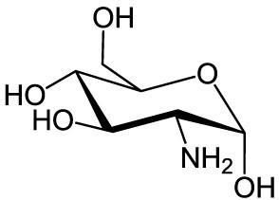
History
Glucosamine was discovered in 1876 by Dr. Georg Ledderhose through the hydrolysis of chitin with hydrochloric acid.
Stereochemistry was later developed in 1939 by Norman Haworth

Slide 3
Glucosamine
It’s an amino acid monosaccharide that the body produces. It is distributed in cartilage and other connective tissues.
Glucosamine is a GAG (glycosaminoglycan) and proteoglycan precursor. It is used in the body for building connective tissue such as tendons, ligaments, cartilage, and fluid that surrounds joints.

Slide 4
Clinical Application
- Most widely used for osteoarthritis.
- Marketed for reducing pain from osteoarthritis via skin creams or by taken orally.
- Used as an eye drop for dry eyes and during cataract surgery for preserving corneas.
-Used for heart disease, high cholesterol, and iron-deficiency.

Slide 5
What is osteoarthritis?
Most common form of arthritis affecting millions worldwide.
Occurs when the protective cartilage on the ends of bones wears down over time.
Symptoms:
Pain
Stiffness
Tenderness
Loss of flexibility

Slide 6
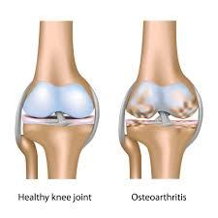
Osteoarthritis

Slide 7
Supplements
Glucosamine supplements often contain additional ingredients such as:
chondroitin sulfate
MSM
shark cartilage
- Thought to work better than taking glucosamine alone, though research provides no proof of added benefits.

Slide 8
Supplements
Most commonly purchased supplements for osteoarthritis:
glucosamine
glucosamine sulfate
glucosamine hydrochloride
n-acetalglucosamine
glucosamine chondrotin
Supplements may not have the same effectiveness.

Slide 9
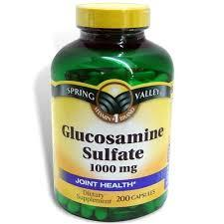
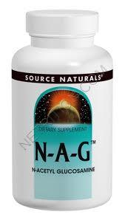
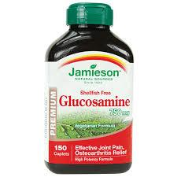
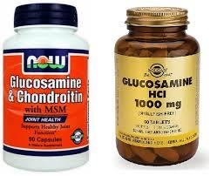
Supplements

Slide 10
Supplements
Supplements can be made from animal bones, bone marrow, cartilage, shells of shellfish and also fungi.
It can also be made in a laboratory.

Slide 11
Supplements
Researchers think glucosamine supplements will increase cartilage and fluid surrounding joints. Resulting in the reversal of the physical effects of osteoarthritis and decreasing the symptoms associated with it.
It’s also believed to prevent the breakdown and slow the progression of osteoarthritis.

Slide 12
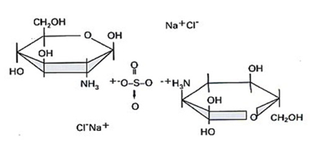
Glucosamine Sulfate
Most scientific research has been done on glucosamine sulfate and its effects on osteoarthritis.

Slide 13
Study #1
2006 study published in the New England Journal of Medicine.
Glucosamine/chondroitin Arthritis Intervention Trial (GAIT).
Consisted of over 1500 people suffering from knee osteoarthritis.
People were given glucosamine, chondroitin sulfate, both, celecoxib (NSAID), or placebo.
Severity of pain was recorded throughout the study.

Slide 14
Study #1
Conclusion:
Glucosamine and chondroitin sulfate alone or in combination did not show significant efficacy in reducing pain in the overall group of patients.
However, patients with mild-severe pain showed higher efficacy with the combination of glucosamine and chondroitin sulfate.

Slide 15
Study #2
2014 double-blind randomised placebo controlled clinical trial.
Patients were given glucosamine sulfate, chondroitin sulfate, combination of the two, or placebo.
605 patients suffering from osteoarthritis of the knee.
Studied whether supplementation resulted in reducing the narrowing of the joint space within the medial tibio-femoral compartment.

Slide 16
Study #2
Conclusion:
Combination of glucosamine-chondroitin showed significant efficacy in reducing joint space narrowing.
There was no significant structural effects for the single supplement treatments.
All four groups showed reduced pain in the knees.

Slide 17
Studies
Clinical research on the effectiveness of glucosamine sulfate taken by mouth for osteoarthritis is inconsistent, due to differences in people studied, different products used, or other differences in the study’s design. Overall, the evidence shows that some people with osteoarthritis may experience some benefits.

Slide 18
Side Effects
Studies have found that glucosamine supplements may interact with the anticoagulant drugs.
Drowsiness, sedation, or insomnia may occur.
May affect blood pressure by causing abnormal heart rate and palpitations

Slide 19
Questions
Which of the following is true about Glucosamine?
A) Glucosamine is a GAG
B) Glucosamine is a Proteoglycan
C) Glucosamine is a precursor for GAGs and Proteoglycans
D) None of the above

Slide 20
Questions
Which of the following is true about Glucosamine?
A) Glucosamine is a GAG
B) Glucosamine is a Proteoglycan
C) Glucosamine is a precursor for GAGs and Proteoglycans
D) None of the above

Slide 21
Questions
Which is the most commonly researched glucosamine used for osteoarthritis?
A) glucosamine sulfate
B) glucosamine hydrochloride
C) n-acetalglucosamine
D) glucosamine chondrotin

Slide 22
Questions
Which is the most commonly researched glucosamine used for osteoarthritis?
A) glucosamine sulfate
B) glucosamine hydrochloride
C) n-acetalglucosamine
D) glucosamine chondrotin

Slide 23
Questions
What can glucosamine supplements be made from?
Bone marrow
Shells of shellfish
Fungi
All of the above

Slide 24
Questions
What can glucosamine supplements be made from?
Bone marrow
Shells of shellfish
Fungi
All of the above

Slide 25
Questions
What are symptoms of osteoarthritis?
Hair loss
Loss of appetite
Loss of flexibility
Memory loss

Slide 26
Questions
What are symptoms of osteoarthritis?
Hair loss
Loss of appetite
Loss of flexibility
Memory loss

Slide 27
Resources
1.“National Center For Complementary And Alternative Medicine. "Glucosamine and Chondroitin for Osteoarthritis: What You Need to Know." Glucosamine and Chondroitin: What You Need To Know(01/24/2014): n. pag. Nccam.nih.gov. 24 Jan. 2014. Web. 2 Dec. 2014.
2. "Chondroitin Sulfate: MedlinePlus Supplements." U.S National Library of Medicine. U.S. National Library of Medicine, 21 Aug. 2014. Web. 02 Dec. 2014.
3."Glucosamine and Chondroitin for Osteoarthritis: What You Need To Know." NCCAM. N.p., 10 Nov. 2014. Web. 02 Dec. 2014
4.GS, Kelly. "Result Filters." National Center for Biotechnology Information. U.S. National Library of Medicine, Feb. 1998. Web. 02 Dec. 2014.
5.Haworth, W., W. Lake, and S. Peat. "Journal of the Chemical Society (Resumed)." The Configuration of Glucosamine (chitosamine) - (RSC Publishing). Journal of Chemical Society, 2010. Web. 02 Dec. 2014.
6."Osteoarthritis." Definition. Mayo Clinic, 09 Oct. 2014. Web. 30 Nov. 2014.
7."Glucosamine." Natural Standard. Natural Standard Professional Monograph, 02 Feb. 2014. Web. 02 Dec. 2014.
8."Glucosamine Sulfate." WebMD. WebMD, 2009. Web. 02 Dec. 2014.
9.Clegg, Daniel O., Domenic J. Reda, and Crystal L. Harris. "Glucosamine, Chondroitin Sulfate, and the Two in Combination for Painful Knee Osteoarthritis — NEJM." New England Journal of Medicine. The New England Journal of Medicine, 23 Feb. 2006. Web. 02 Dec. 2014.
10. Fransen, M., N. Agaliotis, and M. Votrubec. "Result Filters." National Center for Biotechnology Information. U.S. National Library of Medicine, 6 Jan. 2014. Web. 02 Dec. 2014.

